Slide 1
FITT’S LAW

Slide 2
What is Fitts Law
Fitts’ law states that the amount of time required for a person to move a pointer (e.g., mouse cursor) to a target area is a function of the distance to the target divided by the size of the target. Thus, the longer the distance and the smaller the target’s size, the longer it takes.
Fitts law is depends upon
Amout of time required by pointer to move at target.
Size of target ( e.g button)

Slide 3
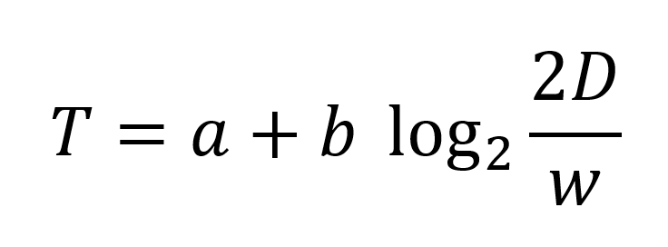
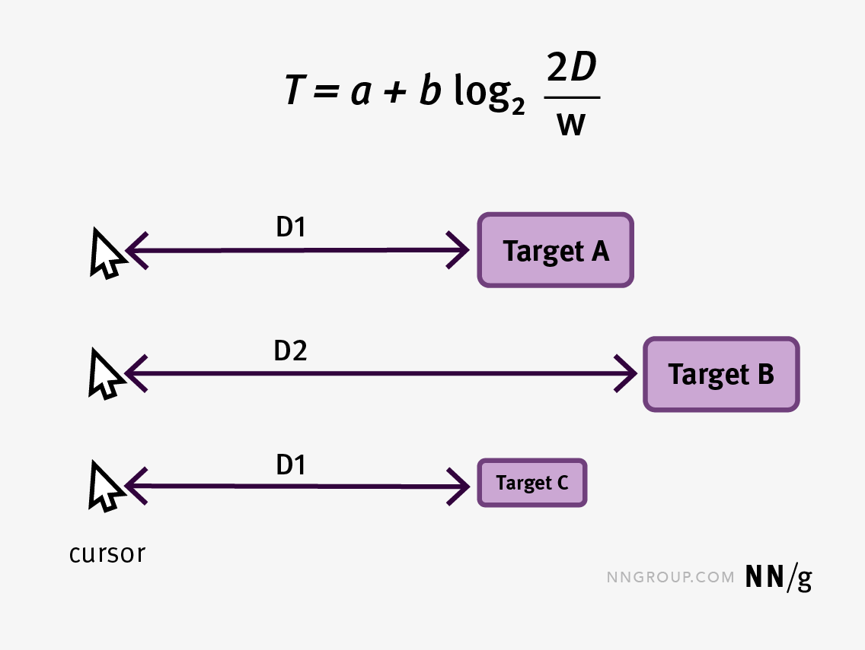
Equation of fits law
Equation of fits laws
where D is the distance to the target, w is the width of the target (technically, measured along the axis of movement), and a and b are constants that vary depending on the type of pointer (e.g., mouse, finger, etc.).

Slide 4
Continue....
Fitts’ s law says that the time to reach Target A is shorter than the time to reach any of the other targets. Although Targets A and B have the same size, the distance from cursor to A (D1) is shorter than the distance to B (D2), so movement to A will be faster. Target C is placed at the same distance (D1) from the cursor as Target A, but it’s smaller, so it will take longer to move the cursor to it than to A.

Slide 5
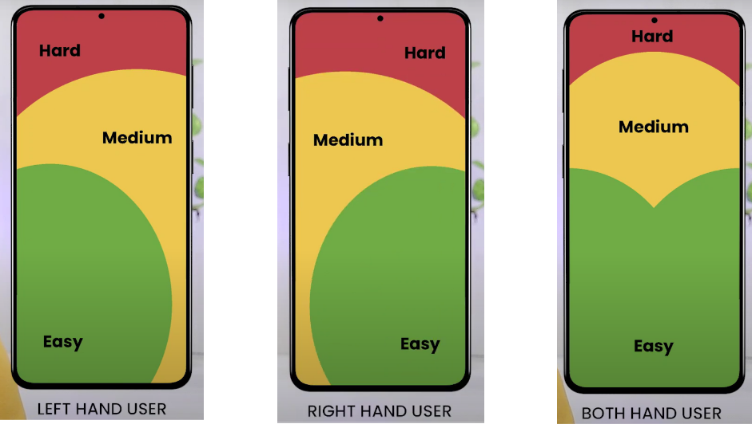
Example of fitts law

Slide 6


Different between using a fits law and not use
Before
After

